Slide 1
Coin Collecting Merit Badge
Troop 344/9344
Pemberville, OH

Slide 2
Coin Collecting Merit Badge Requirements
Understand how coins are made, and where the active U.S. Mint facilities are located.
Explain these collecting terms:
Obverse
Reverse
Reeding
Clad
Type set
Date set
Explain the grading terms Uncirculated, Extremely Fine, Very Fine, Fine, Very Good, Good, and Poor. Show five different grade examples of the same coin type. Explain the term proof and why it is not a grade. Tell what encapsulated coins are.
Know three different ways to store a collection, and describe the benefits, drawbacks, and expense of each method. Pick one to use when completing requirements.

Slide 3
Coin Collecting Merit Badge Requirements
Do ONE of the following:
Demonstrate to your counselor that you know how to use two U.S. or world coin reference catalogs.
Read a numismatic magazine or newspaper and tell your counselor about what you learned.
Describe the 1999–2008 50 State Quarters® program or the America the Beautiful Quarters® program. Collect and show your counselor five different quarters from circulation you have acquired from one of these programs.
Collect from circulation a set of currently circulating U.S. coins. Include one coin of each denomination (cent, nickel, dime, quarter, half-dollar, dollar). For each coin, locate the mint marks, if any, and the designer’s initials, if any.

Slide 4
Coin Collecting Merit Badge Requirements
Do the following:
Identify the people depicted on the following denominations of current U.S. paper money: $1, $2, $5, $10, $20, $50, and $100.
Explain “legal tender.”
Describe the role the Federal Reserve System plays in the distribution of currency.
Do ONE of the following:
Collect and identify 50 foreign coins from at least 10 different countries.
Collect and identify 20 bank notes from at least five different countries.
Collect and identify 15 different tokens or medals.
For each year since the year of your birth, collect a date set of a single type of coin
Do ONE of the following:
Tour a U.S. Mint facility, the Bureau of Engraving and Printing facility, a Federal Reserve bank, or a numismatic museum or exhibit, and describe what you learned to your counselor.
With your parent’s permission, attend a coin show or coin club meeting, or view the website of the U.S. Mint or a coin dealer, and report what you learned.
Give a talk about coin collecting to a group such as your troop, a Cub Scout pack, or your class at school.
Do drawings of five Colonial-era U.S. coins.

Slide 5
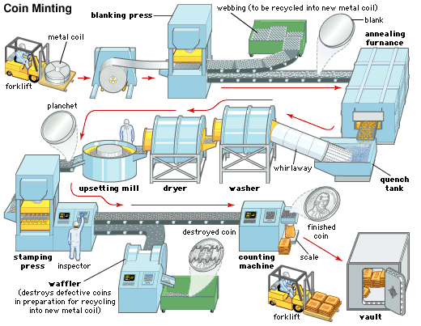
Requirement 1
Understand how coins are made, and where the active U.S. Mint facilities are located.

Slide 6
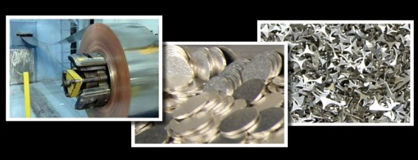
How Coins are Made
Step 1: Blanking
The United States Mint uses rolls of metal that are approximately 13 inches wide and weigh several thousand pounds.
The roll of metal is unwound and flattened to remove the curvature from the manufacturing process.
It is then passed through a machine that punches out discs of metal that are now the proper thickness and diameter for the coin being made.

Slide 7
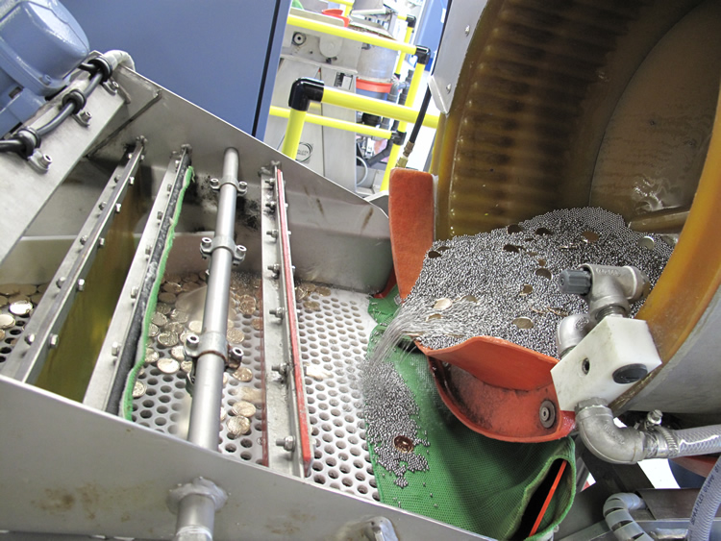
How Coins are Made
Step 2: Riddling
Up to this point, the production process used to fabricate the metal blanks is dirty and is ran in a harsh environment.
It is possible for small pieces of waste metal to get mixed in with the coin blanks.
The riddling machine are mechanical sifters that cull out undersize, oversize and misshapen blanks and from any foreign matter mixed in with the coin blanks.

Slide 8
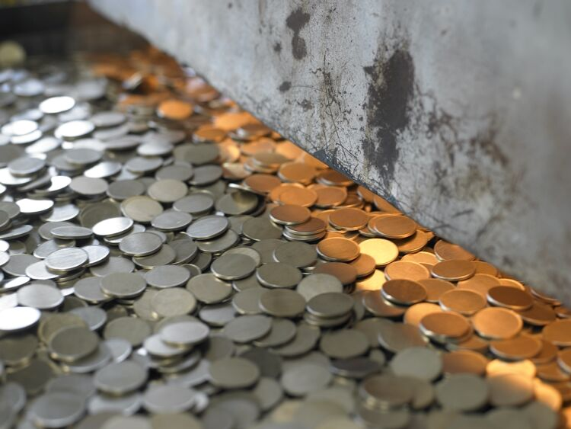
How Coins are Made
Step 3: Annealing and Cleaning
The mint then passes the coin blanks through in the annealing oven to soften the metal in preparation for striking.
From the furnace, they go to a cooling water bath, followed by a polishing/brightening rinse that removes any oil and dirt that may be on the surface of the coin.
Any foreign material can become embedded in the coin during the striking process, and it would have to be scrapped.

Slide 9
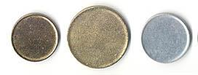
How Coins are Made
Step 4: Upsetting
Upsetting means to “upset” the edge of a coin to create a raised rim.
The upsetting mill feeds the blank into a groove slightly narrower than its diameter.
This pushes the metal up around the edge to form a rim.
This results in a planchet; a plain metal disk from which a coin is made.

Slide 10
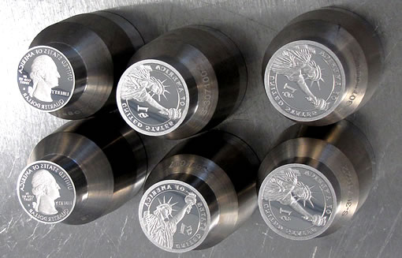
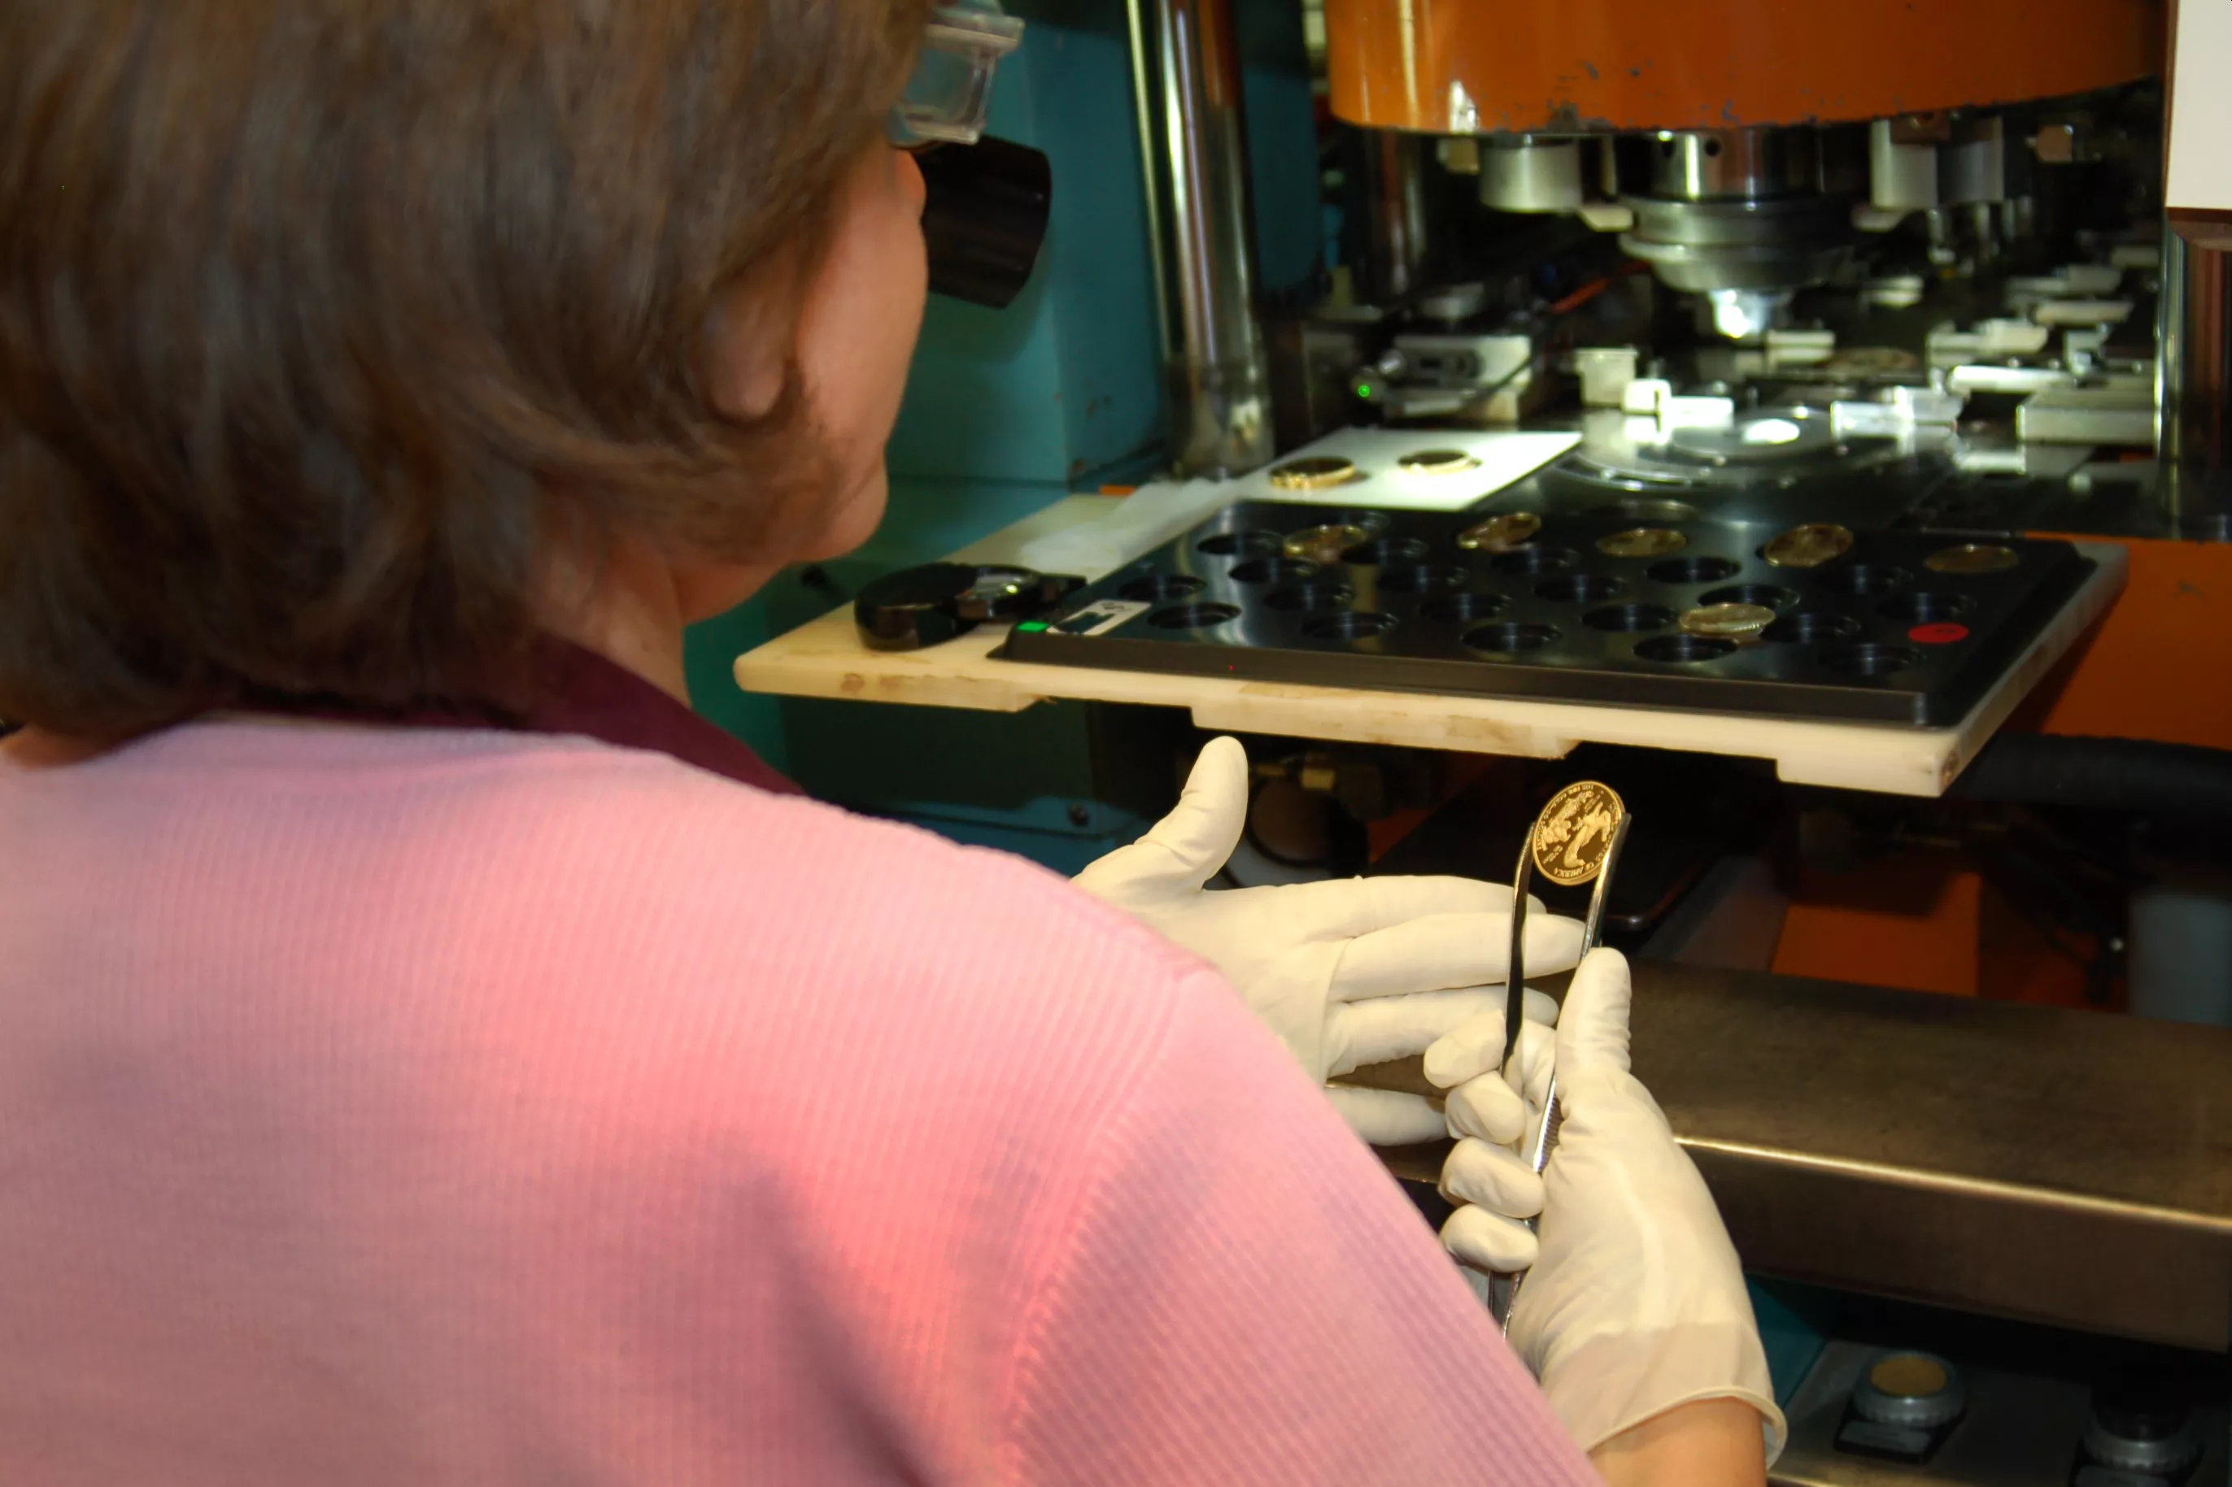
How Coins are Made
Step 5: Stamping or Striking
Now that the planchets have been properly prepared, softened, and cleaned, they are ready for striking.
They are automatically fed into the coining press at a rate that can reach several hundred coins per minute and are stamped with the designs and inscriptions which make them genuine United States coins.
Proof coins made for collectors are fed by hand into the coining press and receive at least two strikes per coin.

Slide 11
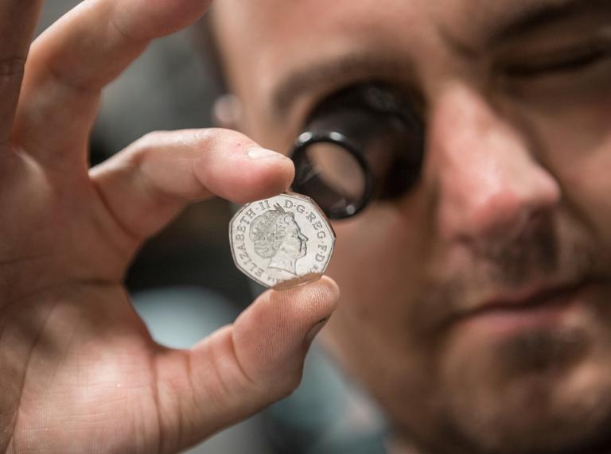
How Coins are Made
Step 6: Inspecting
Press operators using magnifying glasses spot-check each batch of newly struck coins.

Slide 12
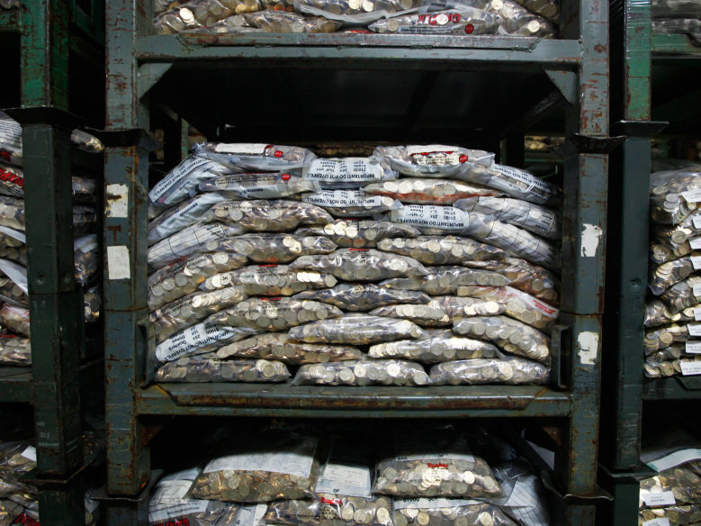
How Coins are Made
Step 7: Counting, Bagging, and Distribution
An automatic counting machine counts the coins and drops them into large bags.
The bags are sealed shut, loaded onto pallets, and taken by forklifts to the vaults for storage.
New coins are shipped by truck to Federal Reserve Banks for distribution to local banks.

Slide 13
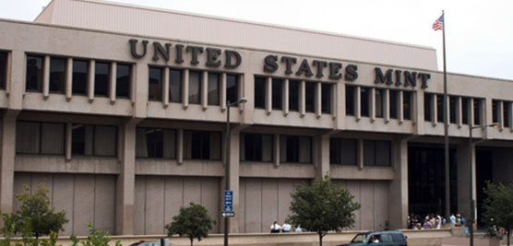
Active U.S. Mints
There are four active coin-producing mints:
Philadelphia
Denver
San Francisco
West Point.

Slide 14
Requirement 2
Explain these collecting terms:
Obverse
Reverse
Reeding
Clad
Type set
Date set

Slide 15
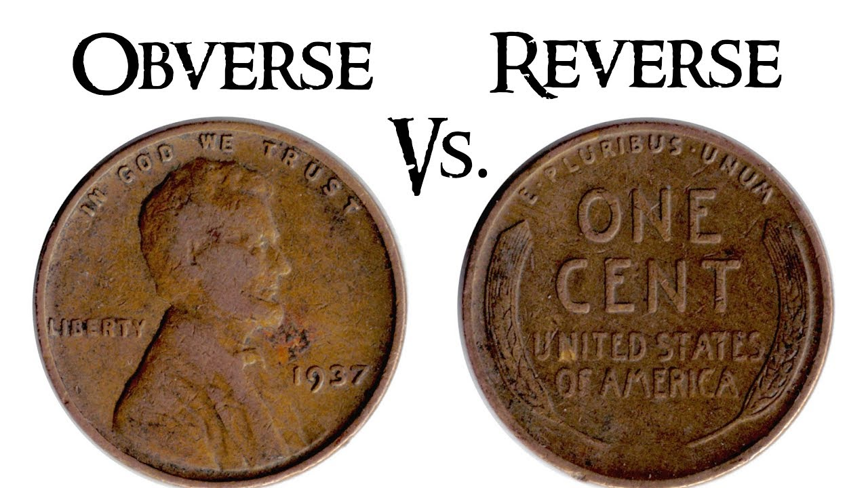
Obverse and Reverse
Obverse means the front face of the object and reverse means the back face.
The obverse of a coin is commonly called heads, because it often depicts the head of a prominent person, and the reverse tails.

Slide 16
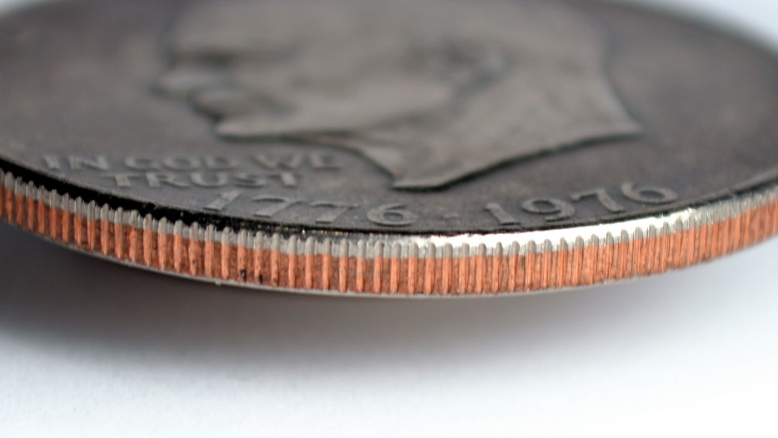
Reeding
The U.S. Mint began adding ridges to the coins' edges, a process called “reeding,” in order to make it impossible to shave them down without the result being obvious.
As a side benefit, the reeded edges also made coin design more intricate and counterfeiting more difficult.

Slide 17
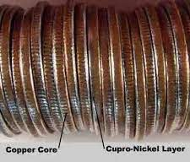
Clad
A clad coin is a coin that has multiple layers of metal in it.
Most current U.S. clad coins consist of an inner core of pure copper, with outer layers of a nickel-copper alloy that looks like silver.
Examples of this type of clad coin are the U.S. Quarter and Half Dollar.

Slide 18
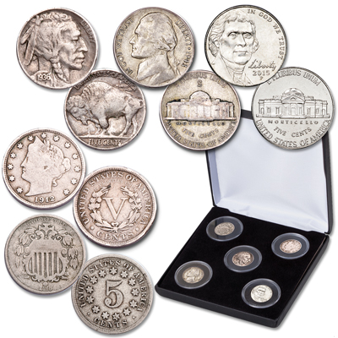
Type Set
Type set is a collection of coins based on denomination that includes all of the different designs.
For example, a nickel type set would contain one of each of the four types of nickels that the United States Mint has produced.

Slide 19
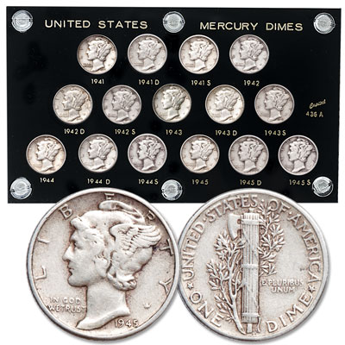
Date set
Date Set: a collection of coins of a single type and denomination that includes every year during a specific date span; for example, a Mercury dime from every year from 1916-1945.

Slide 20
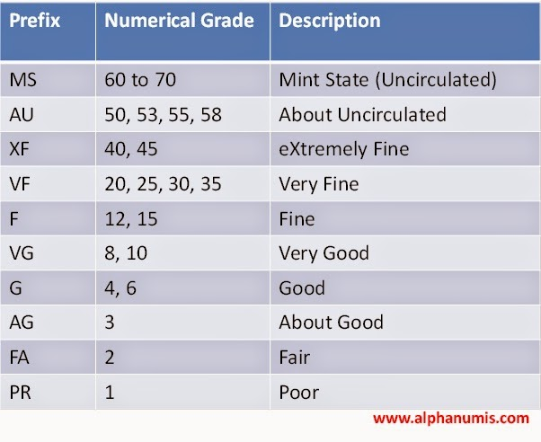
Requirement 3
Explain the grading terms Uncirculated, Extremely Fine, Very Fine, Fine, Very Good, Good, and Poor. Show five different grade examples of the same coin type. Explain the term proof and why it is not a grade. Tell what encapsulated coins are.

Slide 21
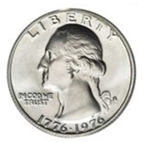
Coin Grading Terms
Uncirculated
The term "uncirculated coin" refers to the condition of a coin that indicates that it has never circulated in the regular money supply in the economy. In other words, the coin shows no signs of wear on any of its surfaces. Since most modern coins are mass-produced in large quantities, it is common that the coin may have small nicks and scrapes on its surface from the production process and being transported in bags and bins. These minor imperfections are not from the coin circulating in commerce, and hence the coin is still considered an uncirculated coin.
Numismatists grade uncirculated coins by taking into account the concentration and quantity of these minor imperfections. Coin collectors grade uncirculated coins using a scale that ranges from MS-60 (a lot of marks and imperfections) to MS-70 (a perfect coin with no marks).

Slide 22
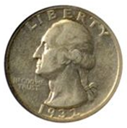
Coin Grading Terms
Extremely Fine
A coin with much of its mint luster, sharp detailing and little sign of being circulated - with only its high spots suffering from slight wear on close inspection.

Slide 23
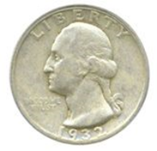
Coin Grading Terms
Very Fine
A coin where all lettering and major features are sharp and most of its fine detail is present. Light to moderate wear can be seen on the coin's surface and high points.

Slide 24
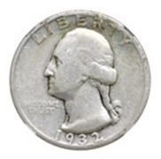
Coin Grading Terms
Fine
A fine coin with date and lettering that are clearly readable, and considerable wear to all its raised surfaces, but more fine detail is present on its main design, such as hairlines.

Slide 25
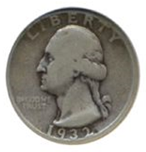
Coin Grading Terms
Very Good
Most of the 'major' details can be clearly read, but it is a coin that's suffered considerable wear over the whole of both surfaces and its high spots are worn through. A coin in this condition is only of value if it is extremely rare.

Slide 26
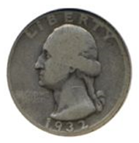
Coin Grading Terms
Good
Sometimes referred to as mediocre, a 'good' coin is (rather confusingly) not really that good at all. Instead, they are usually quite worn, but with an identifiable date and design. This coin condition is not generally sought after by coin collectors unless it is very rare or has a historical value.

Slide 27
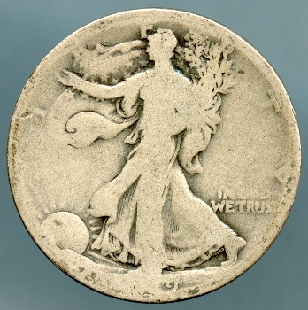
Coin Grading Terms
Poor
In most cases, a coin which is barely identifiable because the date and most of the inscription on it has been worn away. While they may hold sentimental or historical value, these coins are not normally collectable unless they are very rare.

Slide 28
Requirement 4
Know three different ways to store a collection, and describe the benefits, drawbacks, and expense of each method. Pick one to use when completing requirements.

Slide 29
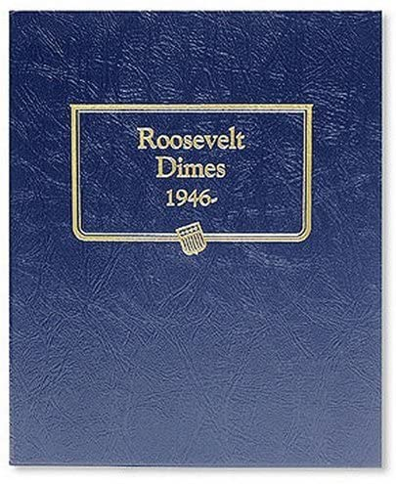
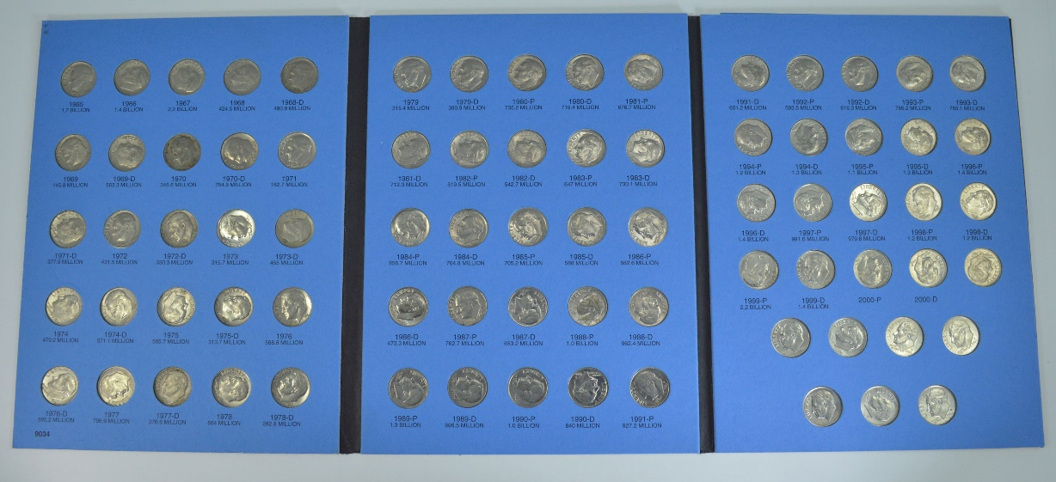
Storing Coins
Coin folders are an economical way to begin collecting.
These are the type of holder that requires you to “push” the coin into its slot.
There are no plastic slides to hold the coin in place.

Slide 30
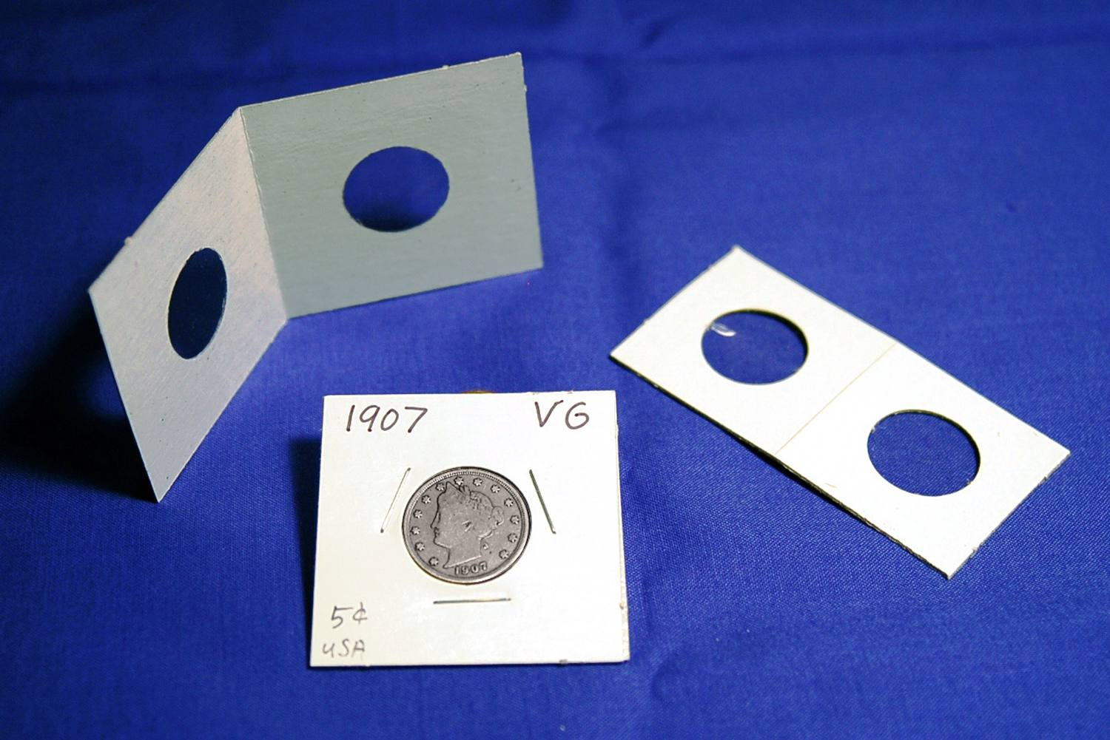
Storing Coins
One of the easiest ways to store coins is the use of two-by-two-inch Mylar holders.
This type of holder permits you to examine both sides of a coin and in such a manner that a fingerprint can not be left on the coin’s surface.
These holders are available in sizes to accommodate every denomination of coin.

Slide 31
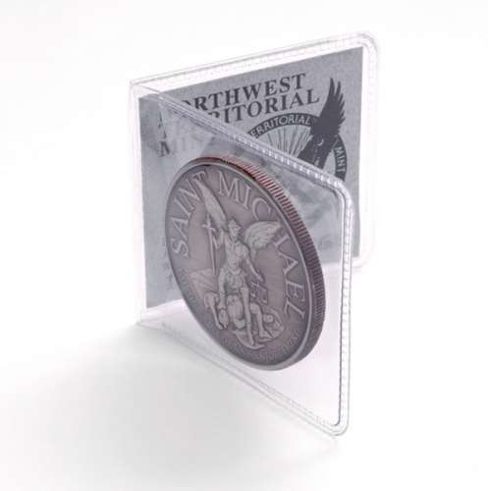
Storing Coins
Coin Collecting “flips”, also in a two-by-two-inch size are another choice.
These allow the viewing of both sides of the coin as well as the edge.
The flip is divided into two sections.
The front section is for the coin while the back section is reserved for the paper two-by-two card on which you may enter the date, denomination, grade and any other information that you require.

Slide 32
Requirement 5
Do ONE of the following:
Demonstrate to your counselor that you know how to use two U.S. or world coin reference catalogs.
Read a numismatic magazine or newspaper and tell your counselor about what you learned.

Slide 33
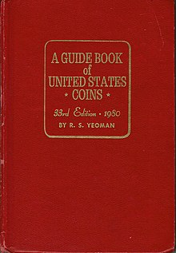
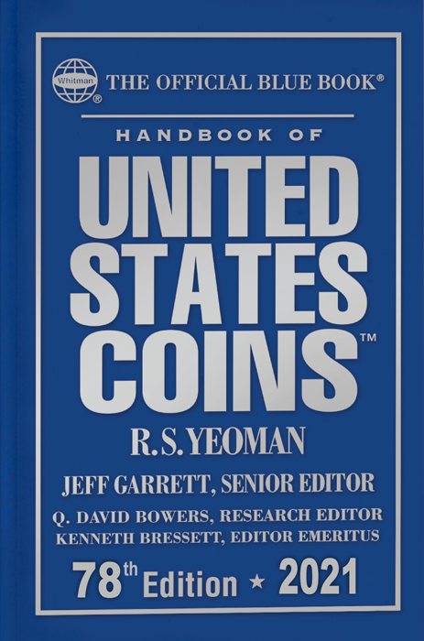
Coin Reference Catalogue
A Guide Book of United States Coins, first compiled by R. S. Yeoman in 1946, is a price guide for coin collectors of coins of the United States dollar, is commonly known as the Red Book.
Along with its sister publication, the older Handbook of United States Coins (The Official Blue Book), it is considered an authoritative U.S. coin price guide. The Guide Book and Handbook got their nicknames (and now official trademarks), the "Red Book" and the "Blue Book," due to their respective solid red and blue covers. Both books are published annually, dated for the following year.
The Red Book lists the retail price of all United States coins from colonial issues to modern circulating U.S. coins, including each year of issue, mint marks, and significant design variations.
In addition, the Red Book lists commemorative coins, mint sets and proof sets, and bullion coins. Each listing includes variable prices based on a coin's measured quality, or grade.

Slide 34
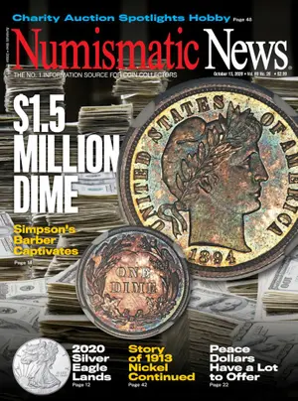
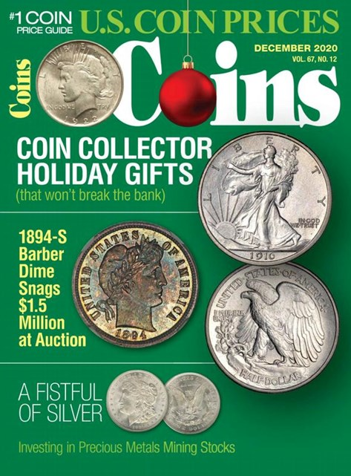
Numismatic Magazines and Newspapers
Most coin collectors read at least one trade publication to see what’s happening in the industry, who has coins or currency for sale that may interest them, who’s buying what, timely coin prices, coin show and auction schedules, and similar current information and news.
Coin Prices is published six times per year.
Coin Values is a monthly magazine.
Coin World is a must-read weekly newspaper that’s been published since 1952.
Coins is a monthly magazine.
Numismatic News is a weekly newspaper that has been published since 1952.
Numismatist is for anyone with any interest in coins. It has been published monthly since 1888 and is included in the American Numismatic Association basic membership package.
World Coin News is a monthly magazine.
WorldWide Coins is a magazine published six times per year.

Slide 35
Requirement 6
Describe the 1999–2008 50 State Quarters® program or the America the Beautiful Quarters® program. Collect and show your counselor five different quarters from circulation you have acquired from one of these programs.

Slide 36
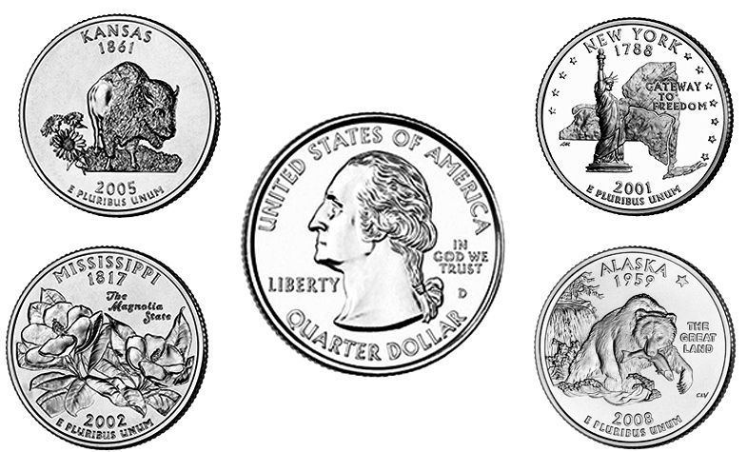
50 State Quarters Program
Launched in 1999, the United States Mint’s 50 State Quarters Program was a 10-year initiative that honored each of the nation’s states in the order that they ratified the Constitution or were admitted into the Union.
Each quarter was produced for about 10 weeks and will never be produced again.
State designs are displayed on the reverse (tails) of the quarters, while the obverse design displays the familiar image of George Washington.
But, to accommodate state designs on the reverse, the words “United States of America,” “Quarter Dollar,” “Liberty,” and “In God We Trust” all appear on the obverse.

Slide 37
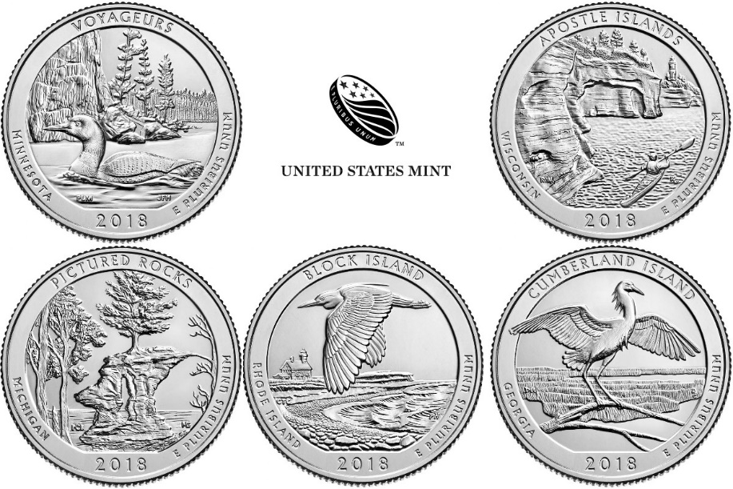
America the Beautiful Quarters Program
The America the Beautiful quarters are a series of 56 quarters issued by the United States Mint starting in 2010 and scheduled to continue until 2021.
The obverse (front) of all the coins depicts George Washington in a modified version of the portrait used for the original 1932 Washington quarter.
There will be five new reverse (back) designs each year and one in 2021, each commemorating a national park or national site – one from each state, the federal district, and each territory.
The program is authorized by the America’s Beautiful National Parks Quarter Dollar Coin Act of 2008.

Slide 38
Requirement 7
Collect from circulation a set of currently circulating U.S. coins. Include one coin of each denomination (cent, nickel, dime, quarter, half-dollar, dollar). For each coin, locate the mint marks, if any, and the designer’s initials, if any.

Slide 39
Cent
Designer Initials
Mint Mark
Designer Initials

Slide 40
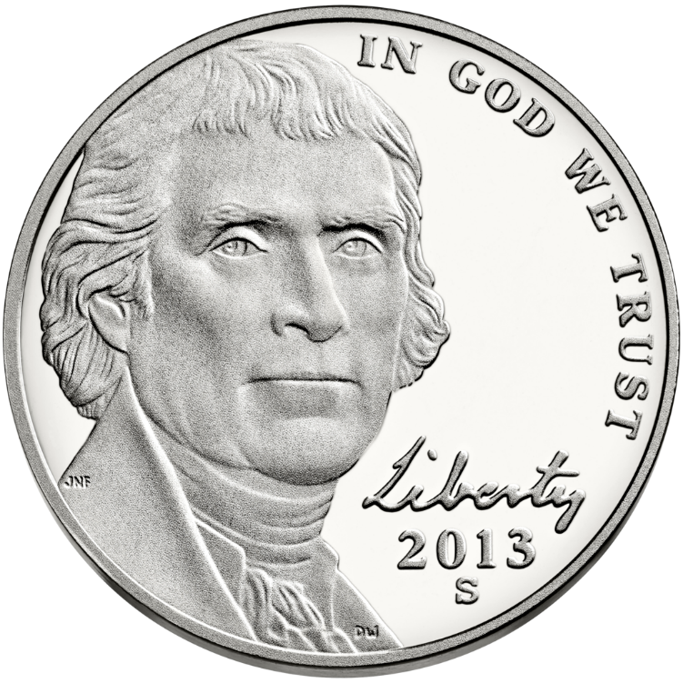
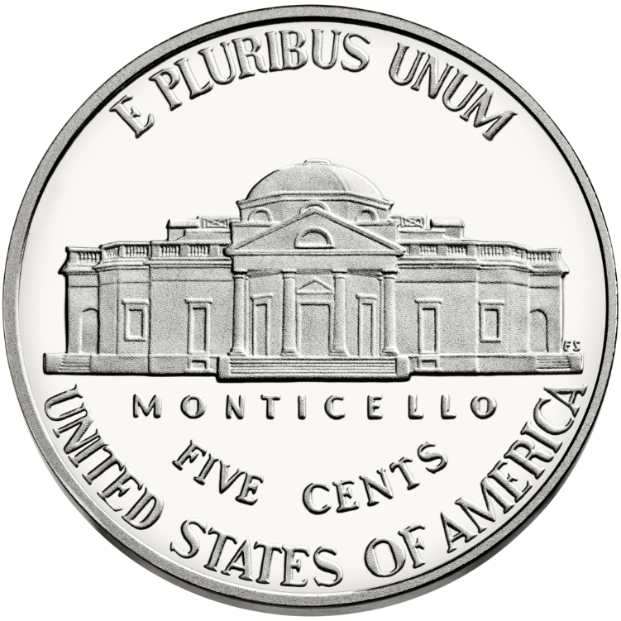
Nickel
Designer Initials
Mint Mark
Designer Initials

Slide 41
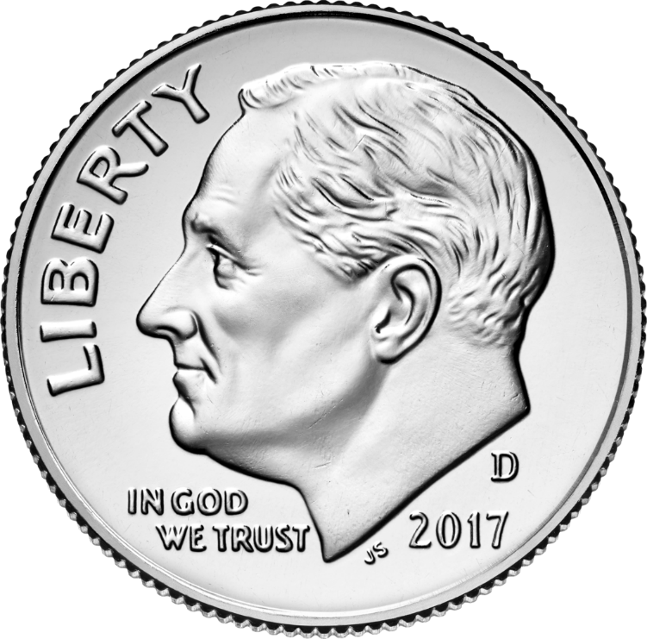
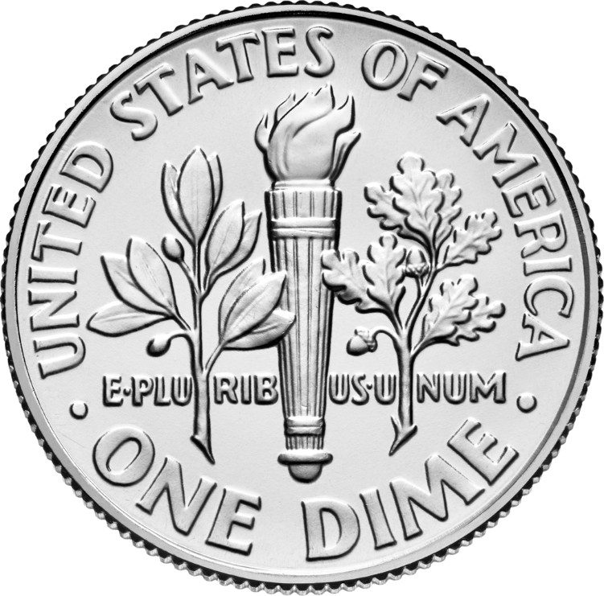
Dime
Designer Initials
Mint Mark

Slide 42
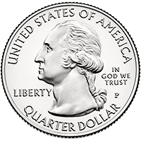
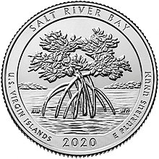
Quarter
Designer Initials
Mint Mark
Designer Initials

Slide 43
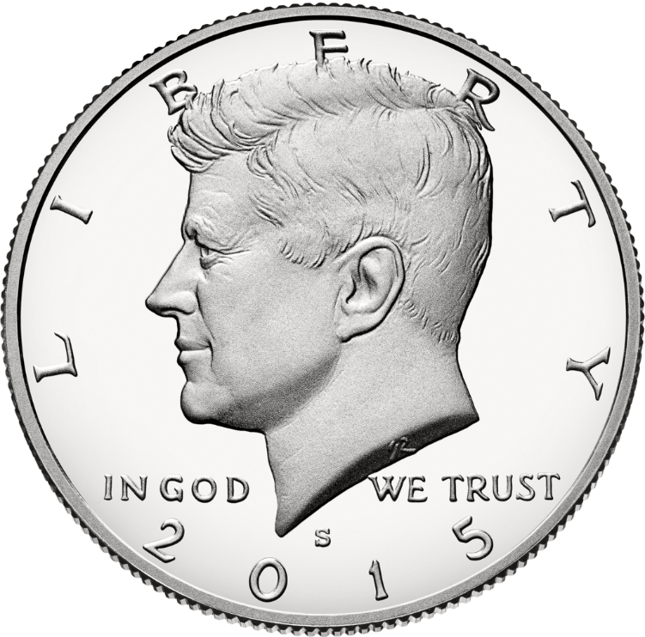
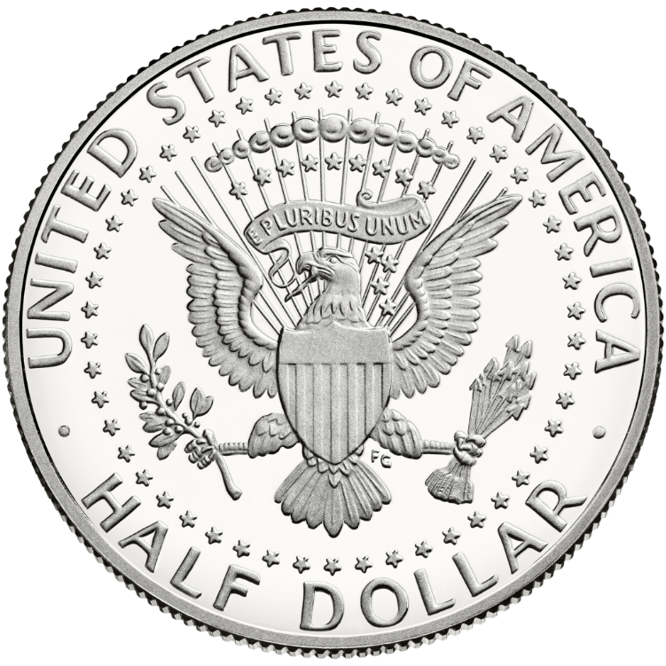
Half Dollar
Mint Mark
Designer Initials

Slide 44
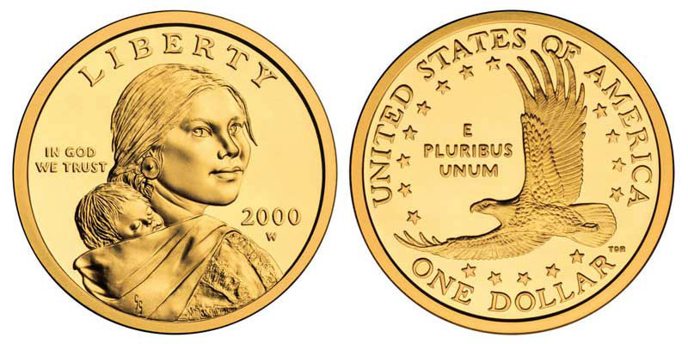
Dollar
Designer Initials
Mint Mark
Designer Initials

Slide 45
Requirement 8
Do the following:
Identify the people depicted on the following denominations of current U.S. paper money: $1, $2, $5, $10, $20, $50, and $100.
Explain “legal tender.”
Describe the role the Federal Reserve System plays in the distribution of currency.

Slide 46
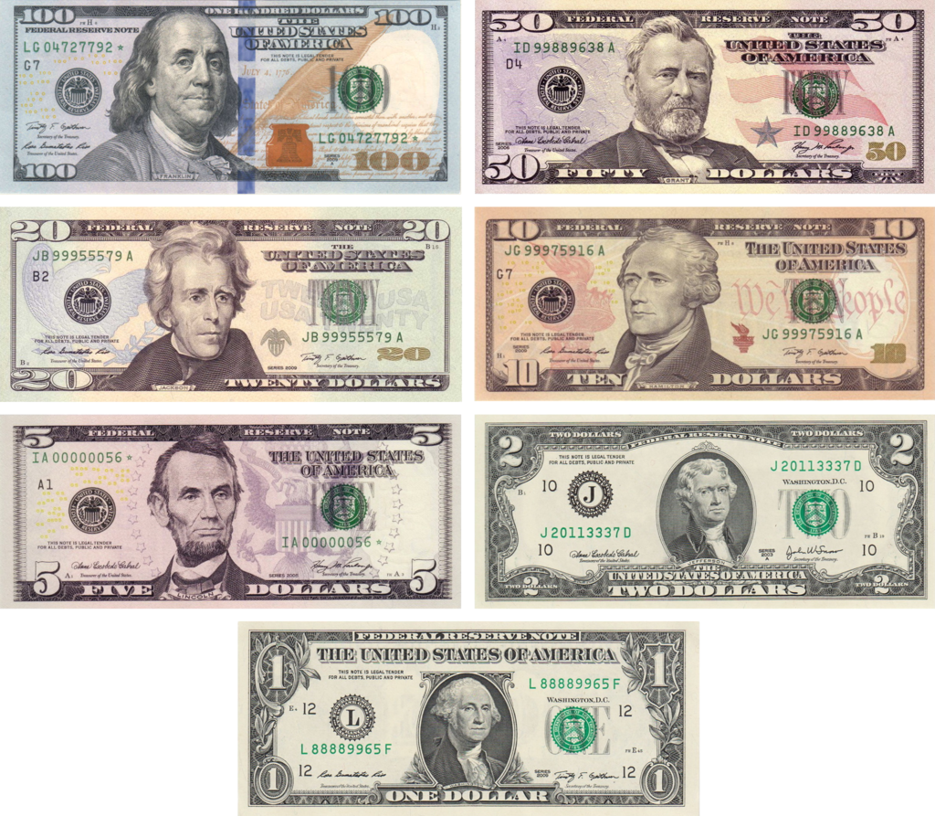
Portraits on U.S. Paper Currency
$1 George Washington
$2 Thomas Jefferson
$5 Abraham Lincoln
$10 Alexander Hamilton
$20 Andrew Jackson
$50 Ulysses S Grant
$100 Benjamin Franklin

Slide 47
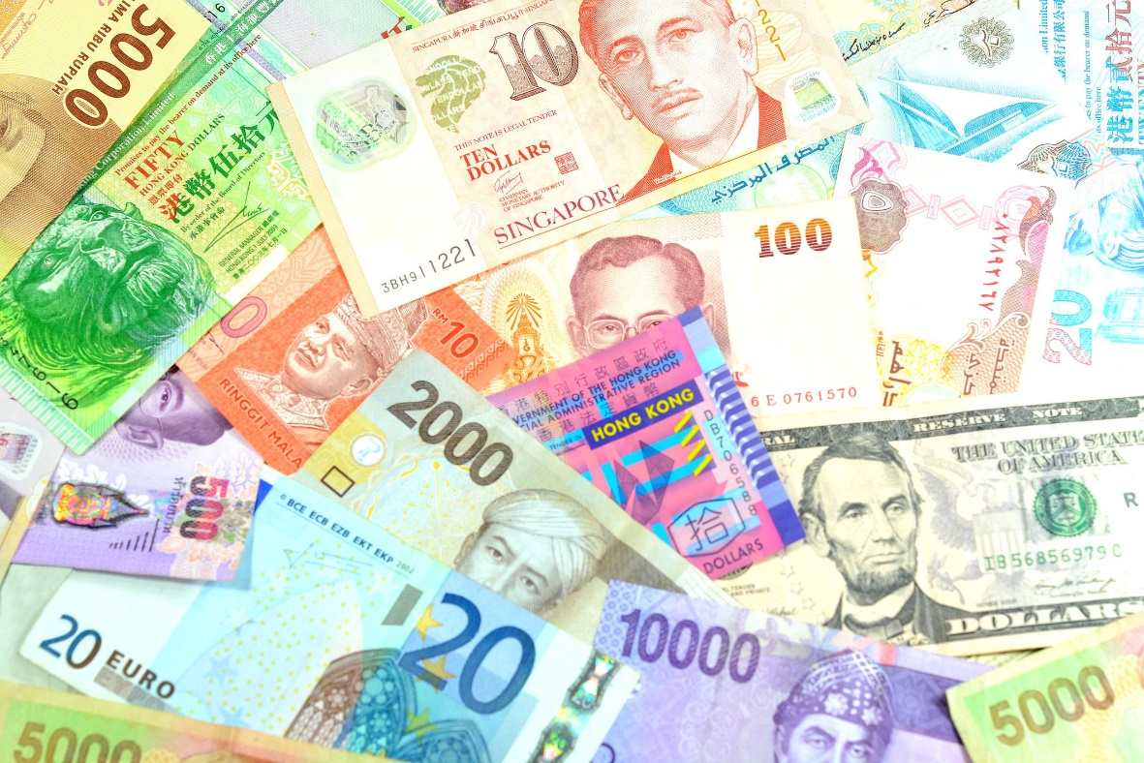
Legal Tender
Legal tender is the national currency, such as paper money and coins, that is declared by law to be valid payment for debts and financial obligations.

Slide 48
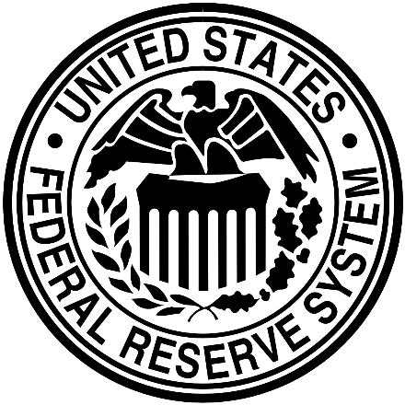
Federal Reserve System
When you receive cash from a bank, you have confidence that the money is genuine U.S. currency. However, that wasn’t always true. Prior to the formation of the Federal Reserve System in 1913, counterfeiting was a serious concern and even being able to get cash from your local bank might have been a challenge, particularly if you lived in a remote part of the country.
Since their inception, the 12 regional banks of the Federal Reserve System have been responsible for a number of important national and regional banking functions, including the distribution of currency and coin and ensuring that the currency is genuine and fit for commerce.
The Federal Reserve System operates 28 cash processing locations in the United States, providing U.S. currency and coin to financial institutions domestically and around the world. Banks in the United States order currency and coin from the Federal Reserve (Fed) and deposit excess banknotes back with the Fed.
The Federal Reserve Cash Services function is responsible for validating the authenticity of each note, removing and destroying worn or damaged notes from circulation, and turning over suspected counterfeit notes to the U.S. Secret Service for investigation.

Slide 49
Requirement 9
Do ONE of the following:
Collect and identify 50 foreign coins from at least 10 different countries.
Collect and identify 20 bank notes from at least five different countries.
Collect and identify 15 different tokens or medals.
For each year since the year of your birth, collect a date set of a single type of coin.

Slide 50
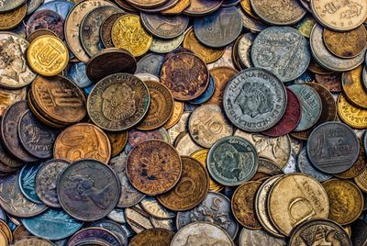
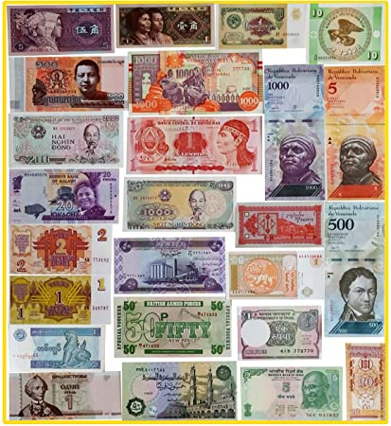
Foreign Coins and Bank Notes
One way to start collecting foreign coins and bank notes is by attending local and domestic auctions. Coin auctions allow you to buy, sell and find values for foreign currency.
Another option would be to travel to a country and exchange American currency for foreign coins directly.

Slide 51
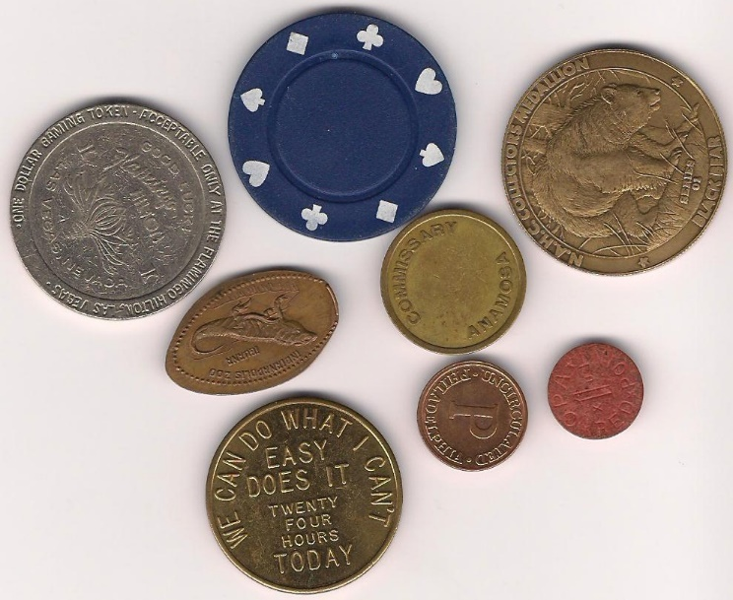
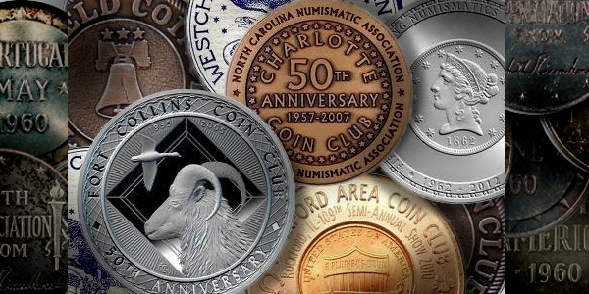
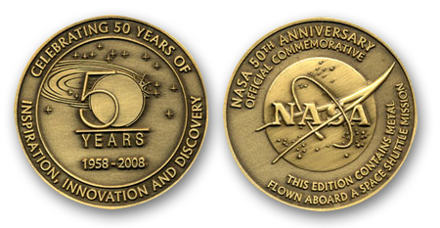
Medals and Tokens
A token is a coin-like object that is usually made of metal and represents a particular value or coin. Token are sometimes referred to as "Good Fors" because they may be "Good For" or exchangeable for a particular item (like one glass of soda) or service (like one hair cut). Some can be traded for actual money, most cannot. Tokens can advertise a particular merchant or product and can be very interesting and fun to collect.
A medal is a coin-like object that is struck for award, celebration or commemoration. Unlike a token or coin, they have no stated value. Medals can be beautiful, elaborate pieces of art and are highly collectible.

Slide 52
For each year since the year of your birth, collect a date set of a single type of coin.

Slide 53
Requirement 10
Do ONE of the following:
Tour a U.S. Mint facility, the Bureau of Engraving and Printing facility, a Federal Reserve bank, or a numismatic museum or exhibit, and describe what you learned to your counselor.
With your parent’s permission, attend a coin show or coin club meeting, or view the website of the U.S. Mint or a coin dealer, and report what you learned.
Give a talk about coin collecting to a group such as your troop, a Cub Scout pack, or your class at school.
Do drawings of five Colonial-era U.S. coins.

Slide 54
U.S. Mint Facility
Today, the Mint's headquarters (a non-coin-producing facility) are in Washington D.C.. It operates mint facilities in Philadelphia, Denver, San Francisco, and West Point, New York and a bullion depository at Fort Knox, Kentucky.

Slide 55
Bureau of Engraving and Printing
Washington, DC Facility Department of the Treasury Bureau of Engraving and Printing 14th and C Streets, SW Washington, DC 20228
Public Tours: 1-866-874-2330
Fort Worth, TX Facility Department of the Treasury Bureau of Engraving and Printing 9000 Blue Mound Road Fort Worth, TX 76131
Public Tours: 1-866-865-1194

Slide 56
Federal Reserve Banks

Slide 57
Money Museum
Money Museum Federal Reserve Bank of Cleveland PO Box 6387 Cleveland, OH 44101-1387
Phone: 216-579-3188 Email: learningcenter@clev.frb.org

Slide 58
U.S. Mint Website
https://www.usmint.gov/

Slide 59
Give a talk about coin collecting to a group such as your troop, a Cub Scout pack, or your class at school.

Slide 60
Colonia Era U.S. Coins

